Slide 1



RUN FORREST RUN
A Look At 2016-2019
St. Jude Rock ‘N’ Roll Nashville Half & Full Marathon Data
Brandes Moore – February 19, 2020

Slide 2
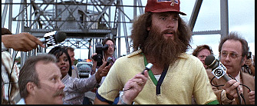
I JUST FELT LIKE RUNNING

Slide 3
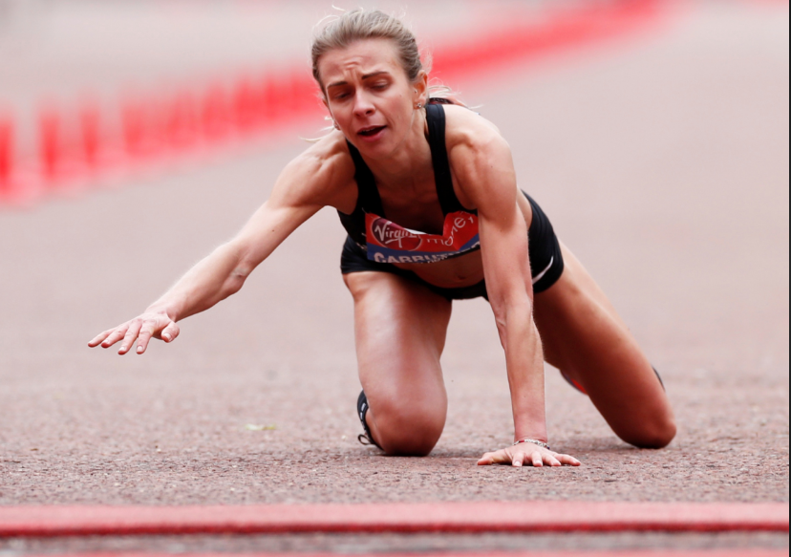
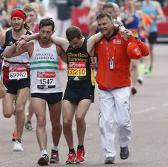
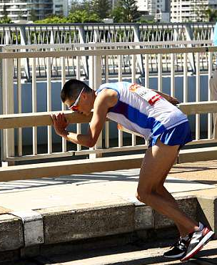
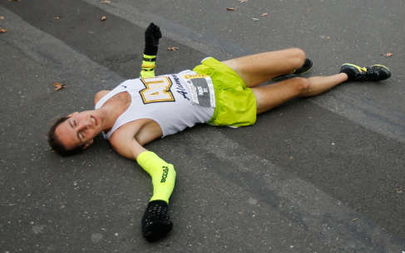
SO YOU THINK YOU CAN RUN A MARATHON?
How long is a 1/2 marathon
13.1 MILES
How long is a marathon
26.2 MILES
AVG Fastest Time (2016-2019)
2:35:15 – 1/2
4:48:27 - full
AVG Slowest Time (2016-2019)
5:16:12 – 1/2
6:44:14 - full

Slide 4
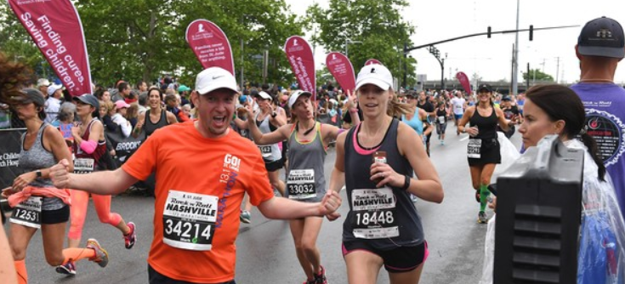
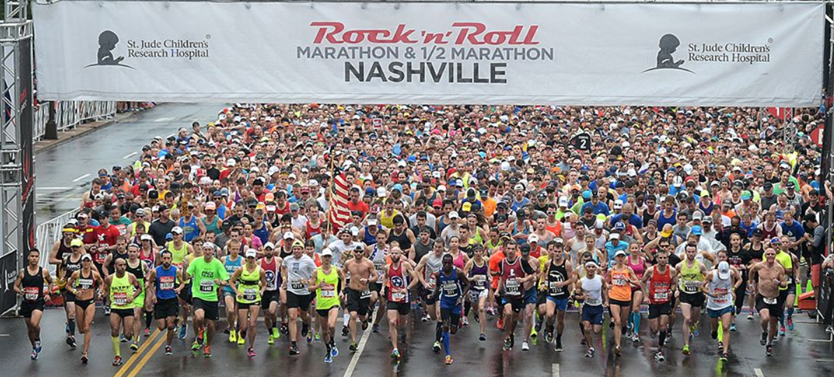
ROCK ‘N’ ROLL NASHVILLE FACTS
An Avg of 16,061 people finished a half marathon during 2016-2019
An Avg of 2,385 people finished a full marathon during 2016-2019
9% avg decline in finishers
Year-Over-Year since 2016

Slide 5

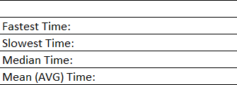
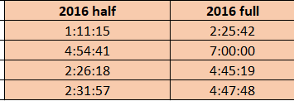
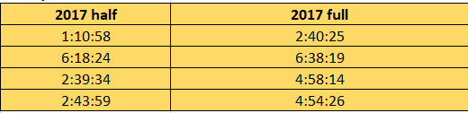
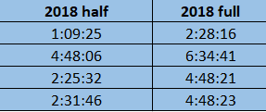
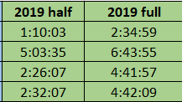
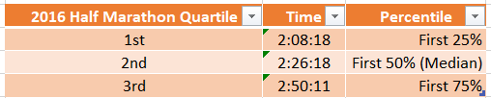
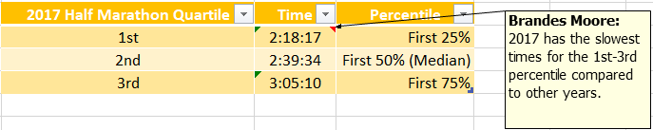
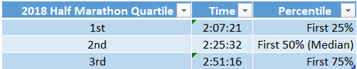
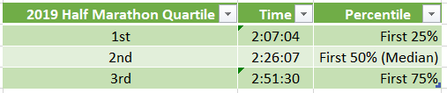
RUN TIME OBSERVATION:
2017 has the largest time percentage change for the slowest, median and mean ½ and full marathon times.
2017 has the slowest times for the 1st-3rd percentile compared to other years.

Slide 6
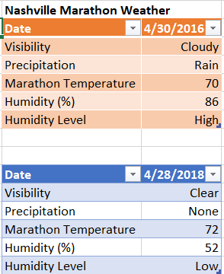
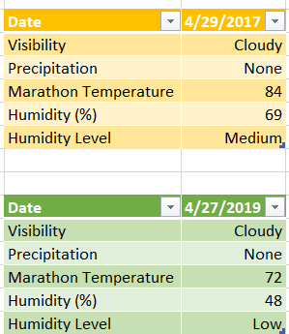
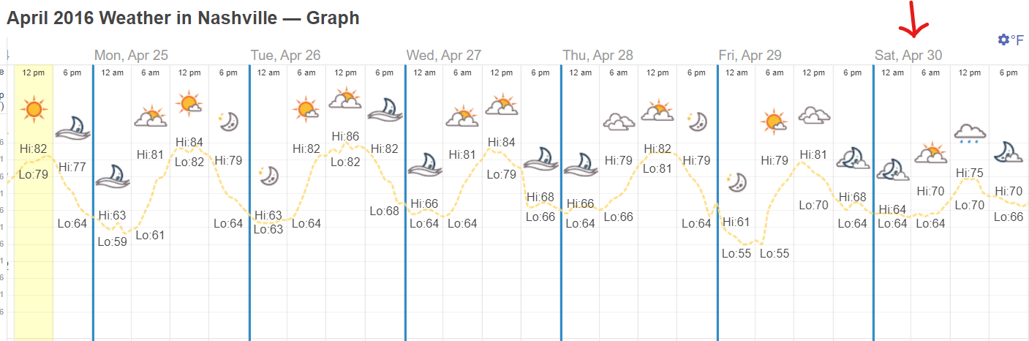
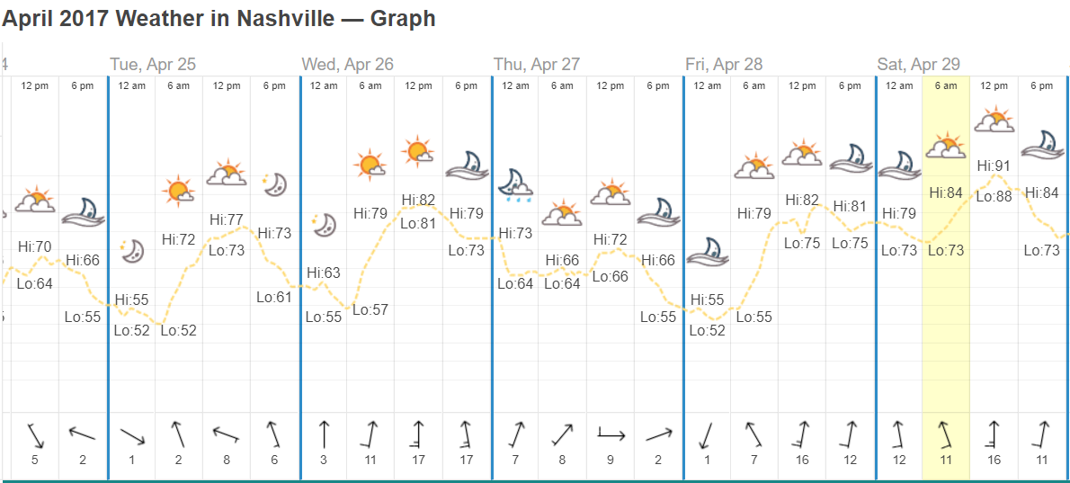
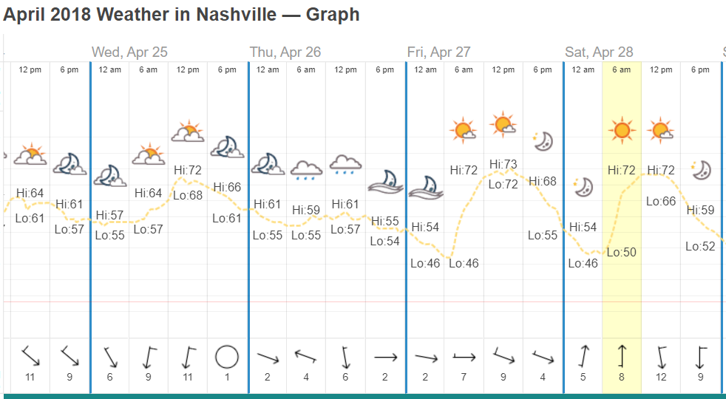
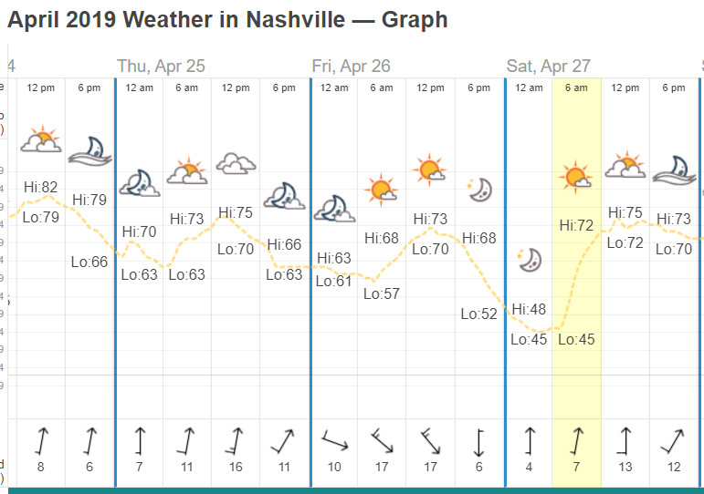
2017 Hypothesis: There was a weather difference during the 2017 races that wasn't present in the other years.
2017 has the largest time percentage change for the slowest, median and mean ½ and full marathon times.
2017 has the slowest times for the 1st-3rd percentile compared to other years.
IT WAS HOT AS HADES !!

Slide 7
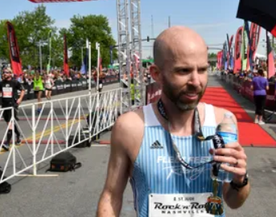
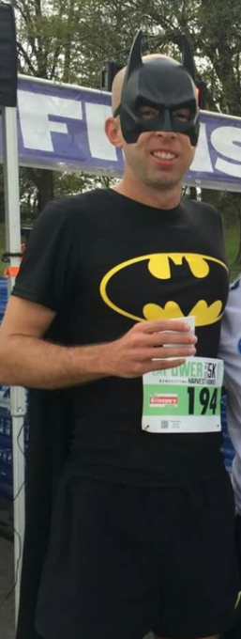
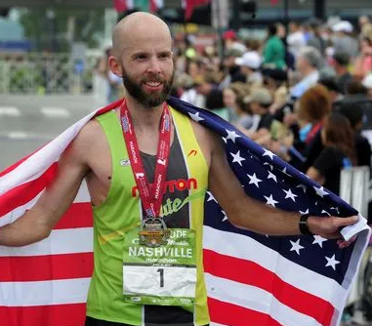
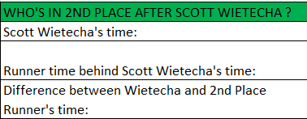
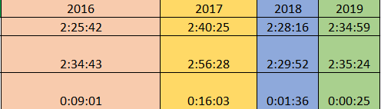
Who is Scott Wietecha (pronounced Why-tech-uh)
37 Years Old
From Hendersonville, TN
PE Teacher for a local Middle School
Rock ‘N’ Roll Nashville Marathon BAD ***
Only Runner to Win seven consecutive years in a row
GUY
HE’S WON 7 IN A ROW, BUT THEY’RE GAINING ON HIM

Slide 8
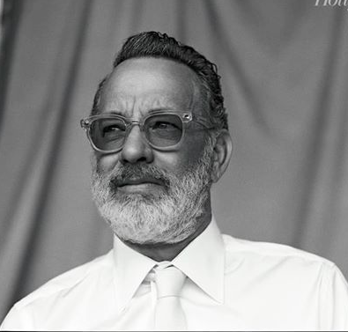


Keep running and you too could look like this at
63 years old.

